Slide 1
Object Oriented Programming Lab CSE 1206
Lab 10

Slide 2
Exception
Exception is a problem that arises during the execution of a program and disrupts the normal flow of the program.
Checked/Compile Time/Other Exception:
Exception that occurs at the compile time, these are also called as Compile Time exceptions.
Unchecked/Runtime Exception:
exception that occurs at the time of execution. These are also called as Runtime Exceptions.

Slide 3
Checked Exception: | Unchecked Exception:
cannot simply be ignored at the time of compilation. | are ignored at the time of compilation. But caught during run time
cannot simply be ignored at the time of compilation, the programmer has to take care of (handle) these exceptions. | the programmer should take care of (handle) these exceptions.
Example: if you want to read a file and the file specified doesn't exist, | Example: logic errors or improper use of an API, or array is out of index.

Slide 4
Errors
Not exceptions at all, but problems that arise beyond the control of the user or the programmer.
Errors are typically created in response to catastrophic failures that cannot usually be handled by the program.
For example,
if a stack overflow occurs, an error will arise.

Slide 5
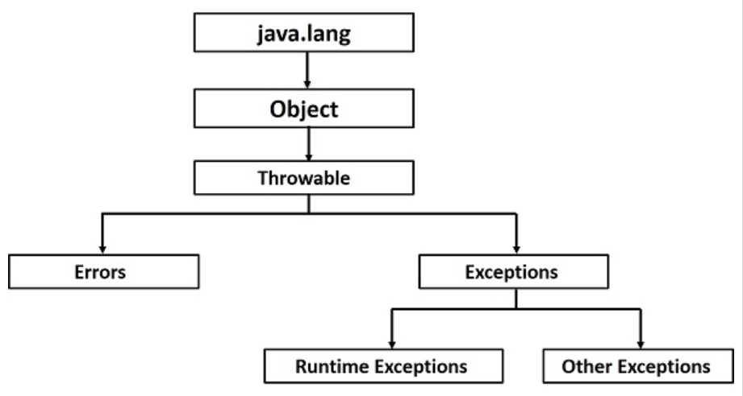
package
Super Class
Subclass of Object
Subclasses of Throwable
SubClasses of Exception

Slide 6
Checked Exception
import java.io.File;
import java.io.FileReader;
public class Demo {
public static void main(String args[]) {
File file = new File("E://file.txt");
FileReader fr = new FileReader(file);
}
}
Will give Error saying to handle the exception

Slide 7
Unchecked Exception
public class Demo {
public static void main(String args[]) {
int num[] = {1, 2, 3, 4};
System.out.println(num[5]);
}
}
Won’t give error but will give exception error after execution

Slide 8
Handling Exceptions
try and catch block
try block used to enclose the Code that might throw an exception
try{
//code that may throw exception
}catch(Exception_class_Name ref)
{
}
catch block is used to
handle the Exception

Slide 9
Problems when Unchecked Exceptions are not Handled
public class Demo {
public static void main(String args[]) {
int data = 10 / 0; //may throw exception
System.out.println("rest of the code...");
}
}

Slide 10
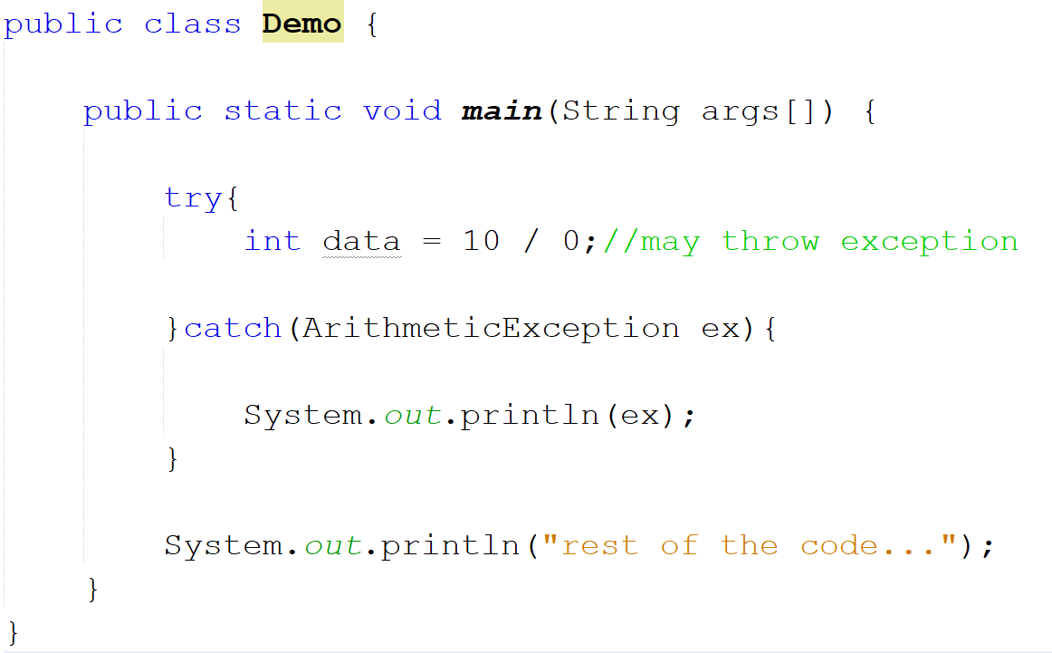

Slide 11
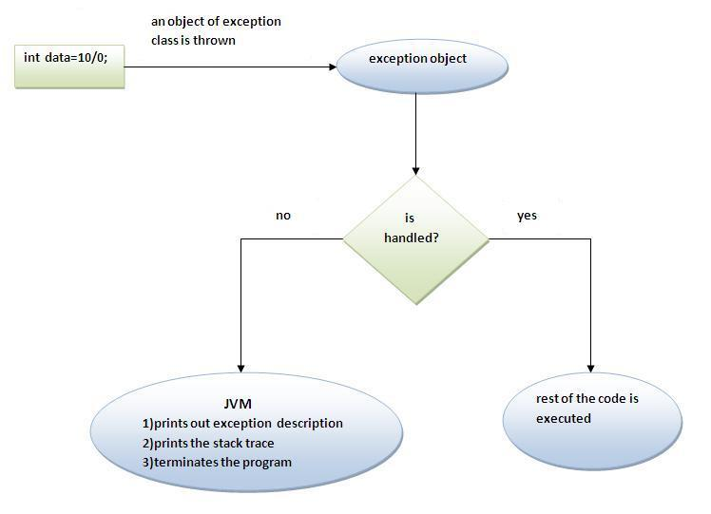

Slide 12
Multiple catch block
try{
//code that may throw exception OR
}catch(Exception1 ref){
} catch(Exception2 ref){
} catch(Exception3 ref){
}
try{
//code that may throw exception
}catch(Exception1|Exception2 |Exception3 ref ){
}
Each catch statement is inspected in order.
The first one whose type matches is executed and others are bypassed.

Slide 13
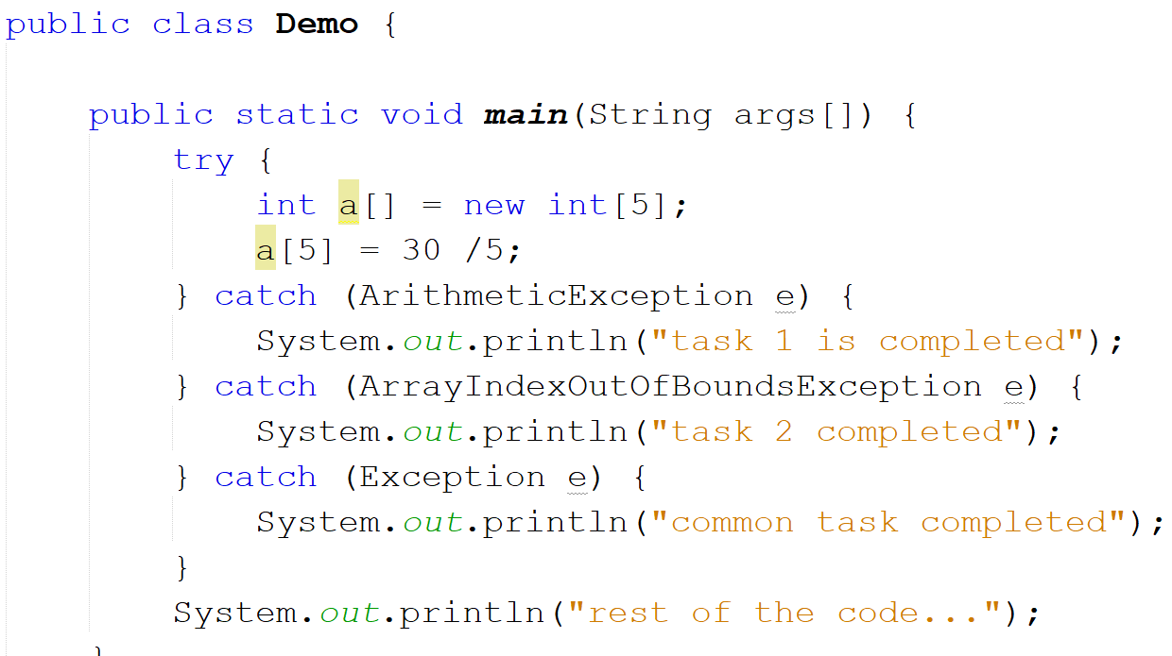

Slide 14
Nested try catch block
try{
//code
try{
//code
}catch(ExceptionName ref){
}
}catch(ExceptionName ref){
}
Sometimes a situation may arise where a part of a block may cause one error and the entire block itself may cause another error. In such cases, exception handlers have to be nested.

Slide 15
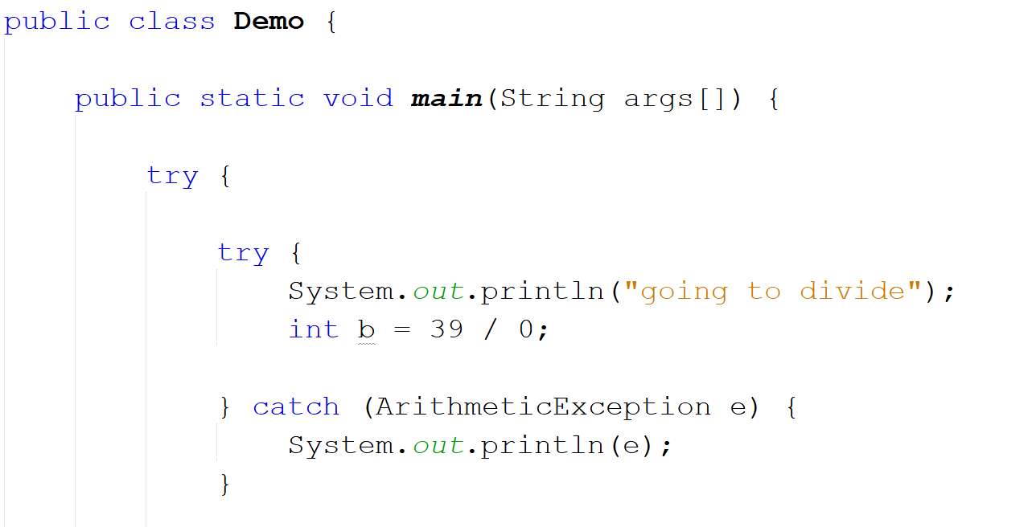

Slide 16
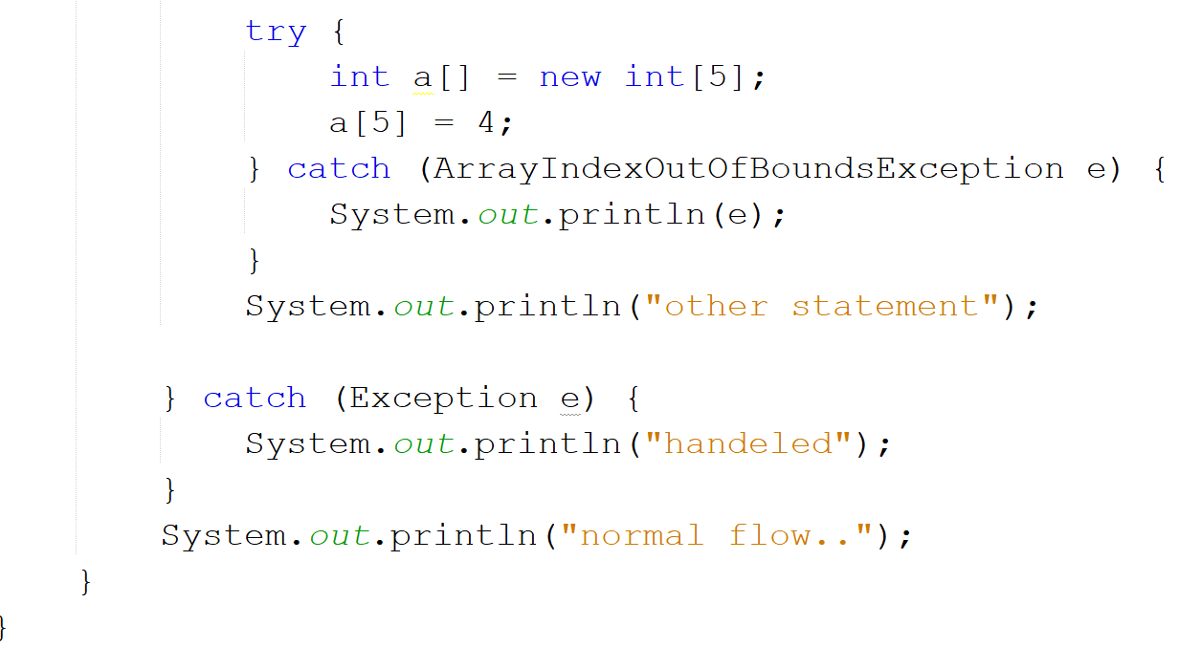

Slide 17
finally block
try {
} catch (Exception ex) { OR
} finally {
}
try {
} finally {
}
Java finally block is a block that is used to execute important code such as closing connection, stream etc.
Java finally block is always executed whether exception is handled or not.

Slide 18
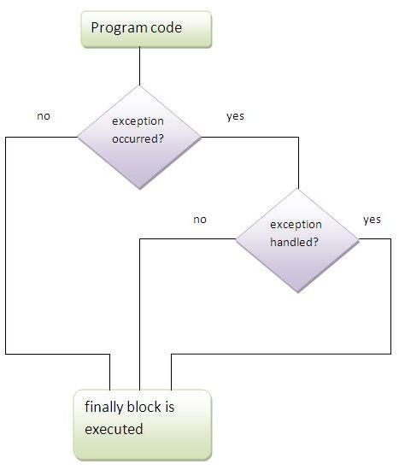

Slide 19
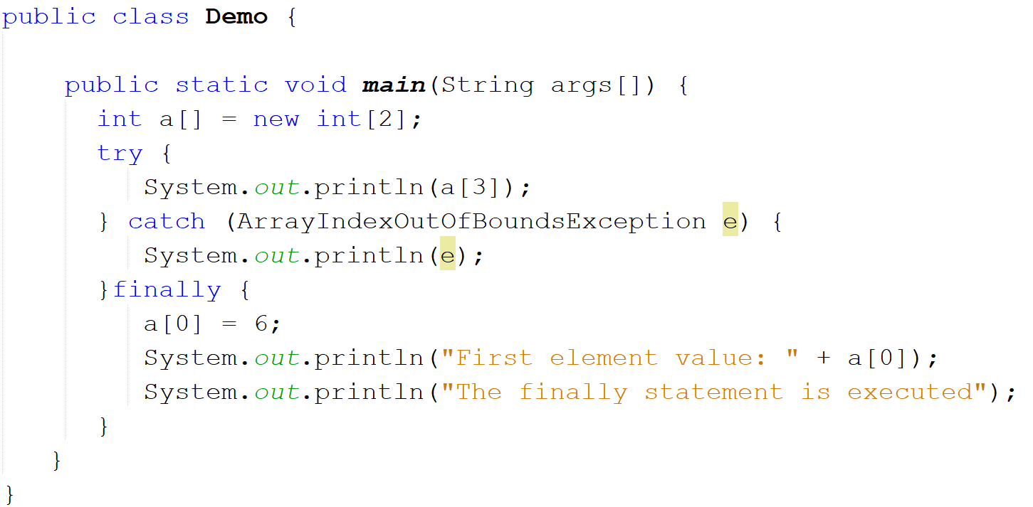

Slide 20
Throwing Customized Exceptions

Slide 21
throw keyword
The Java throw keyword is used to explicitly throw an exception.
We can throw either checked or unchecked exception in java by throw keyword. Mainly used to throw custom exception.
The syntax of java throw keyword is given below
throw throwableInstance;
Here, throwableInstance must be an object of type Throwable or a subclass of Throwable.
throw new IOException(“demo”);

Slide 22
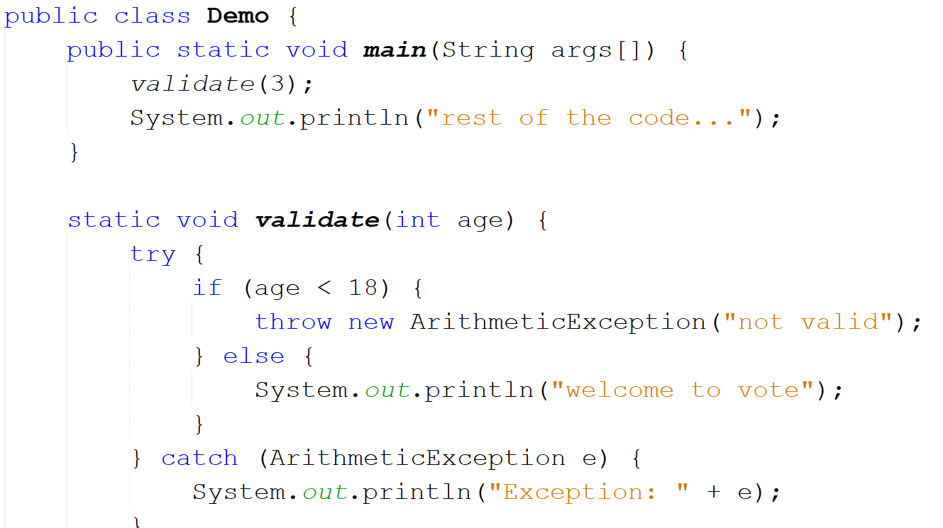

Slide 23
throws keyword
The Java throws keyword is used to suppress a compile time exception.
Mainly used to handle the checked exceptions. If there occurs any unchecked exception such as NullPointerException, it is programmer’s fault that they are not performing check up before the code being used.
return_type method_name() throws exception_class_name{
//method code
}

Slide 24
public class Demo {
public static void main(String[] args) {
try {
useFile();
} catch (FileNotFoundException ex) {
}
}
public static void useFile() throws FileNotFoundException{
File file = new File("//file.txt");
FileReader fr = new FileReader(file);
}
}
When a method with throws Exception is called somewhere then it must be kept in a try catch block or that method should also throw the exception.
Supresses the exception of this line but does not handle it

Slide 25
Creating User Defined Exceptions

Slide 26
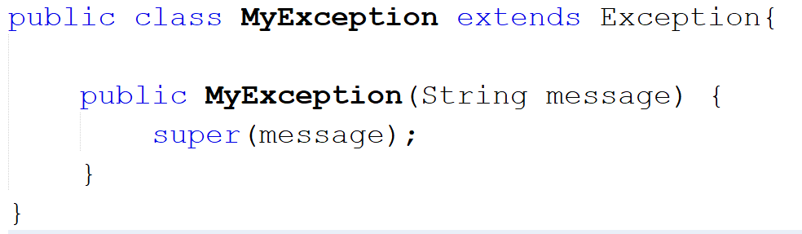
Create a class named MyException

Slide 27
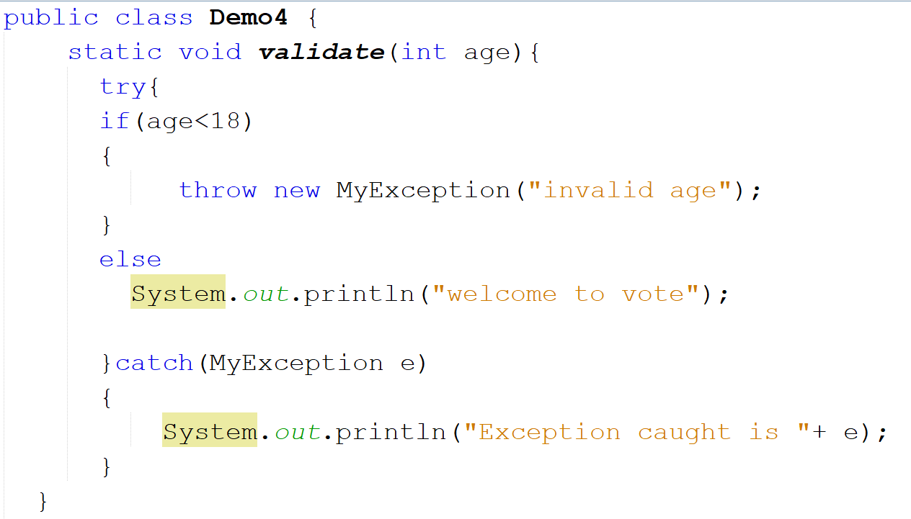

Slide 28
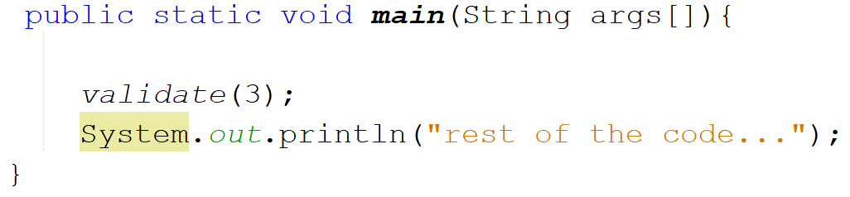
Output:
Exception caught is MyException is caught
rest of the code...
BUILD SUCCESSFUL (total time: 0 seconds)

Slide 29
Reference website https://www.javatpoint.com/exception-handling-in-java

